Slide 1
PMJ Test
Presentation
He Zhuang 2023/01/31

Slide 2
Outline
Question 1:
Data preprocess
Calculation Method
Question 2:
Data preprocess
Data visualization and insights
Solution
Result
Potential Improvement:
Question 3:
DBSCAN on Passenger cluster

Slide 3
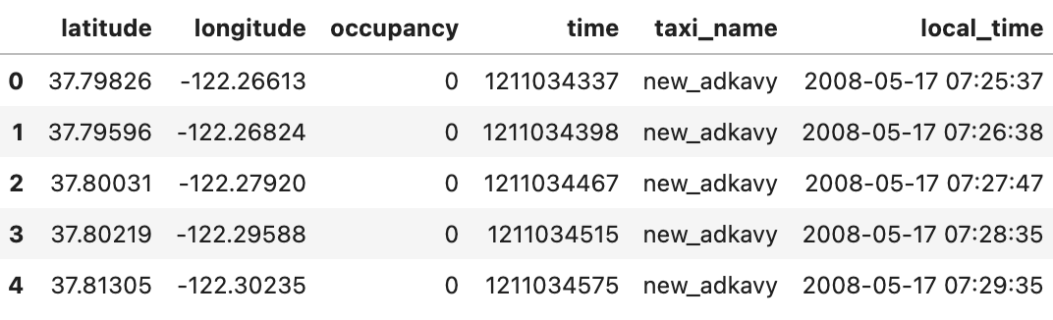
Question 1:
Data preprocess
Data preprocess,
Drop null
Change to unix time to (San Francisco) “local_time” column
Add a “taxi_name” column (based on file name)
Remove “longitude” and “latitude” outlier record (>99.5% or <0.5%)
New columns

Slide 4
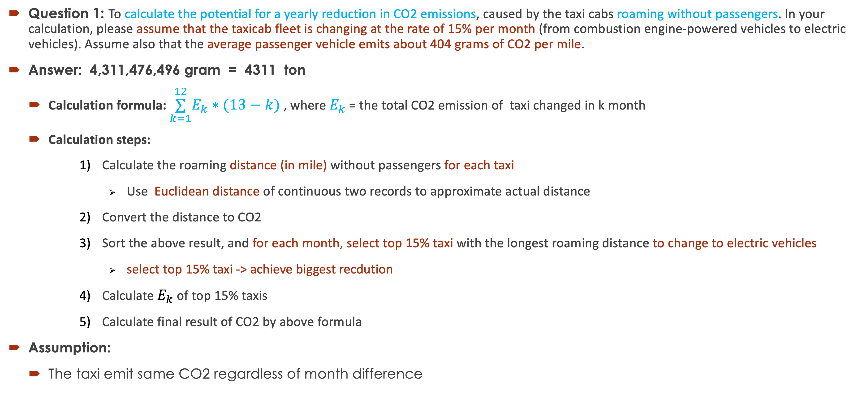
Question 1:
Calculation
Question 1: To calculate the potential for a yearly reduction in CO2 emissions, caused by the taxi cabs roaming without passengers. In your calculation, please assume that the taxicab fleet is changing at the rate of 15% per month (from combustion engine-powered vehicles to electric vehicles). Assume also that the average passenger vehicle emits about 404 grams of CO2 per mile.
Answer: 4,311,476,496 gram = 4311 ton
Calculation formula: $\overset{12}{\underset{k=1}{∑}}E_{k}∗(13−k)$ , where $E_{k}$ = the total CO2 emission of taxi changed in k month
Calculation steps:
Calculate the roaming distance (in mile) without passengers for each taxi
Use Euclidean distance of continuous two records to approximate actual distance
Convert the distance to CO2
Sort the above result, and for each month, select top 15% taxi with the longest roaming distance to change to electric vehicles
select top 15% taxi -> achieve biggest recdution
Calculate $E_{k}$ of top 15% taxis
Calculate final result of CO2 by above formula
Assumption:
The taxi emit same CO2 regardless of month difference

Slide 5
Question 2:
Data preprocess
Data preprocess,
Drop null
Change to unix time to (San Francisco) local time
Add a “taxi_name” column
Add a maker “in_out” column when passenger getting “in” or “out”
Remove outlier record of “longitude” and “latitude” (<0.5% or >99.5%)
Add weekdays “day” and “hour” columns to specify time slot
“day” values: {0:'Monday', 1:'Tuesday', 2:'Wednesday', 3:'Thursday', 4:'Friday', 5:'Saturday', 6:’Sunday’}
Add "drive_id" for each drive (including w/o passengers)
New columns

Slide 6
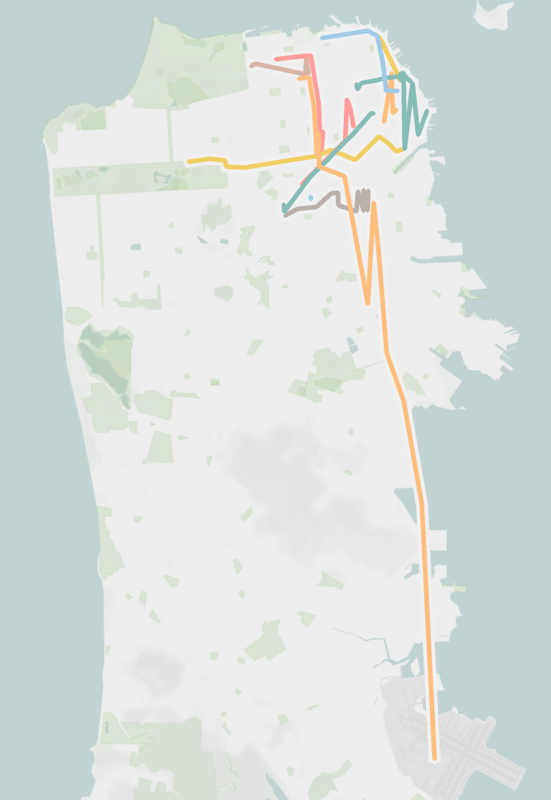
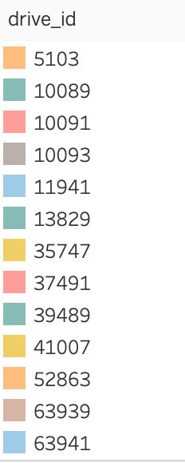
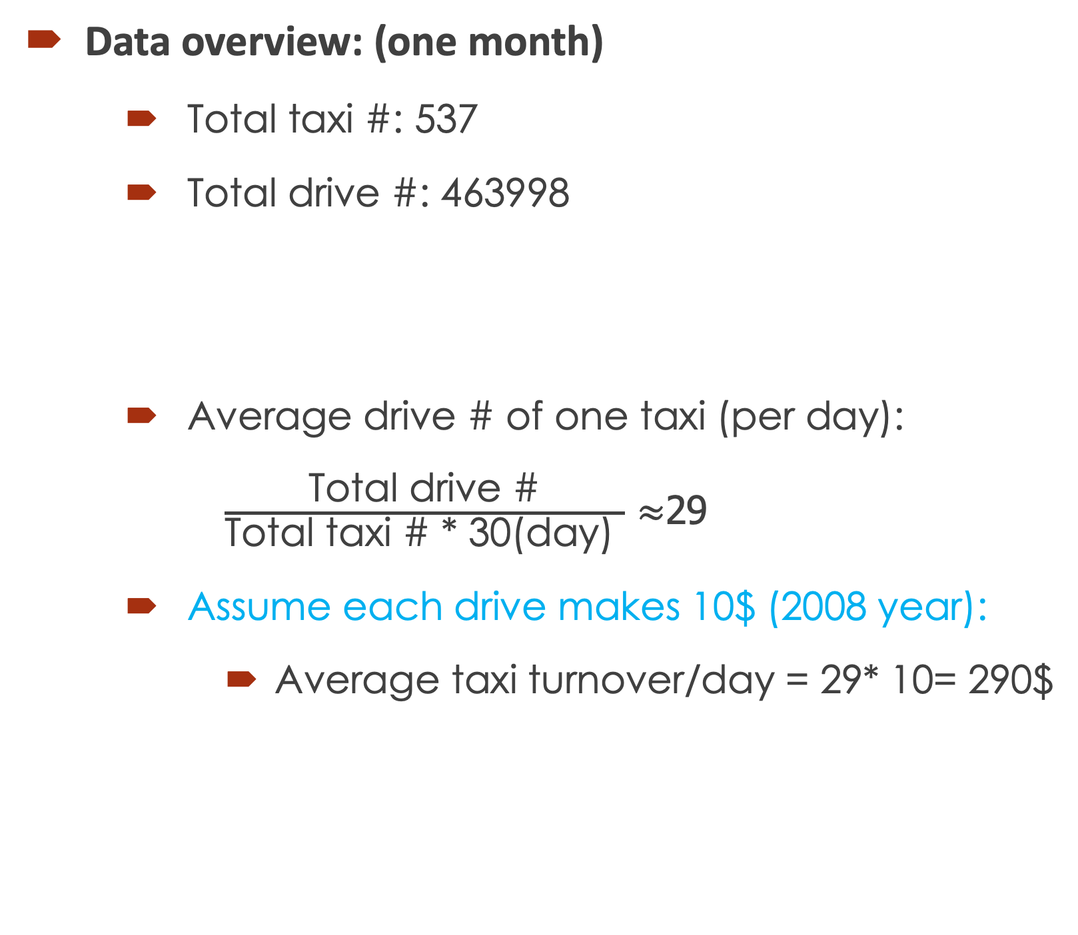
Question 2:
Data visualization and insights
Data overview: (one month)
Total taxi #: 537
Total drive #: 463998
Average drive # of one taxi (per day):
$\frac{\text{Total} \text{drive}\text{ \#}}{\text{Total} \text{taxi}\text{ \# * 30(}\text{day}\text{) }}$ $≈$29
Assume each drive makes 10$ (2008 year):
Average taxi turnover/day = 29* 10= 290$
Some drive route with passengers

Slide 7
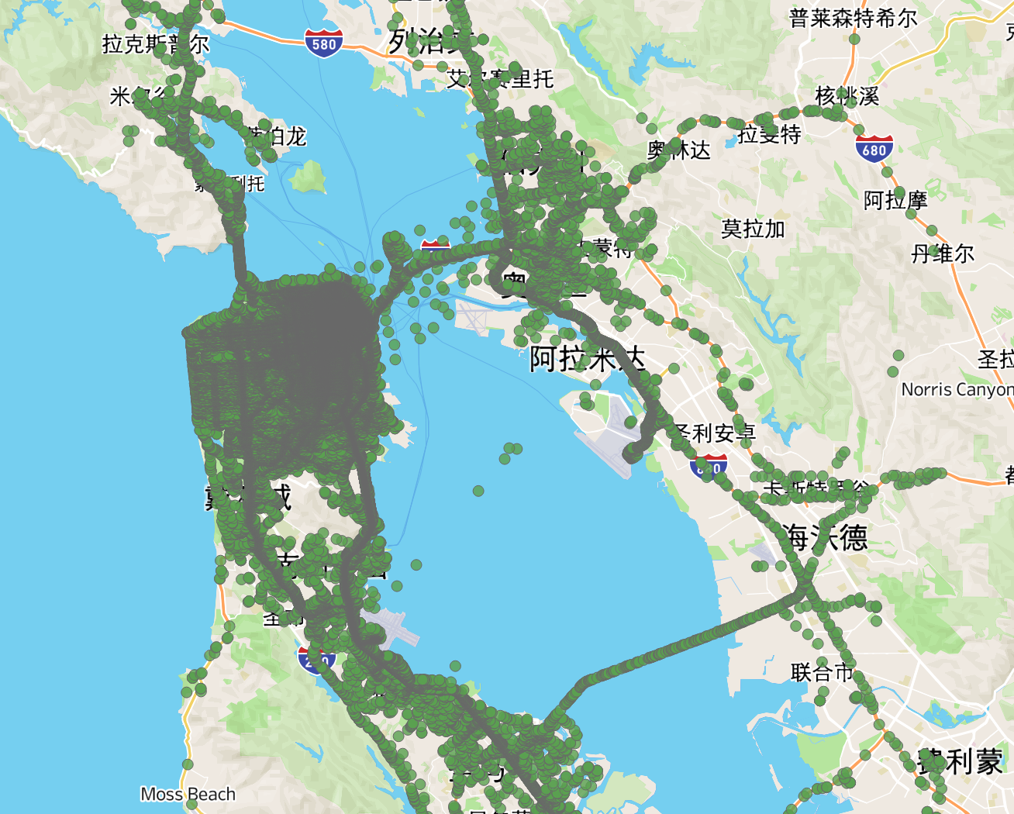
Question 2:
Data visualization and insights
Moving range of taxi with passenger

Slide 8
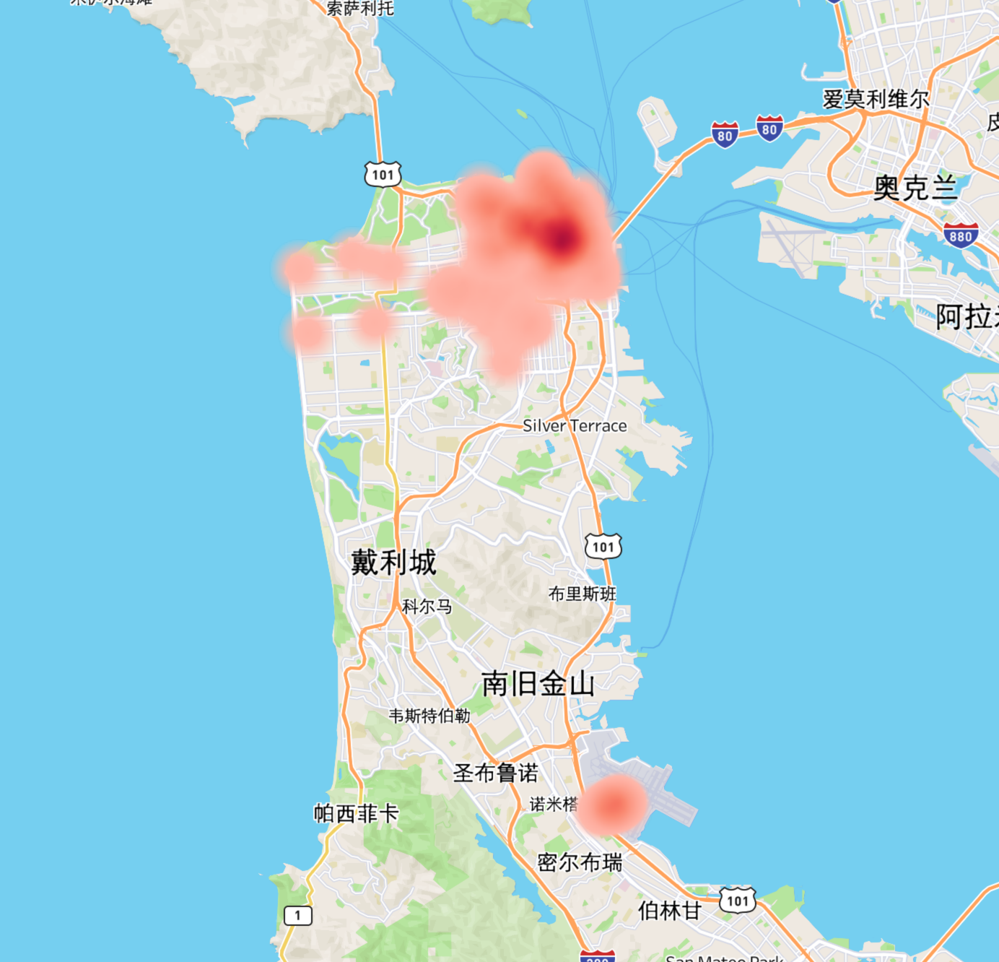
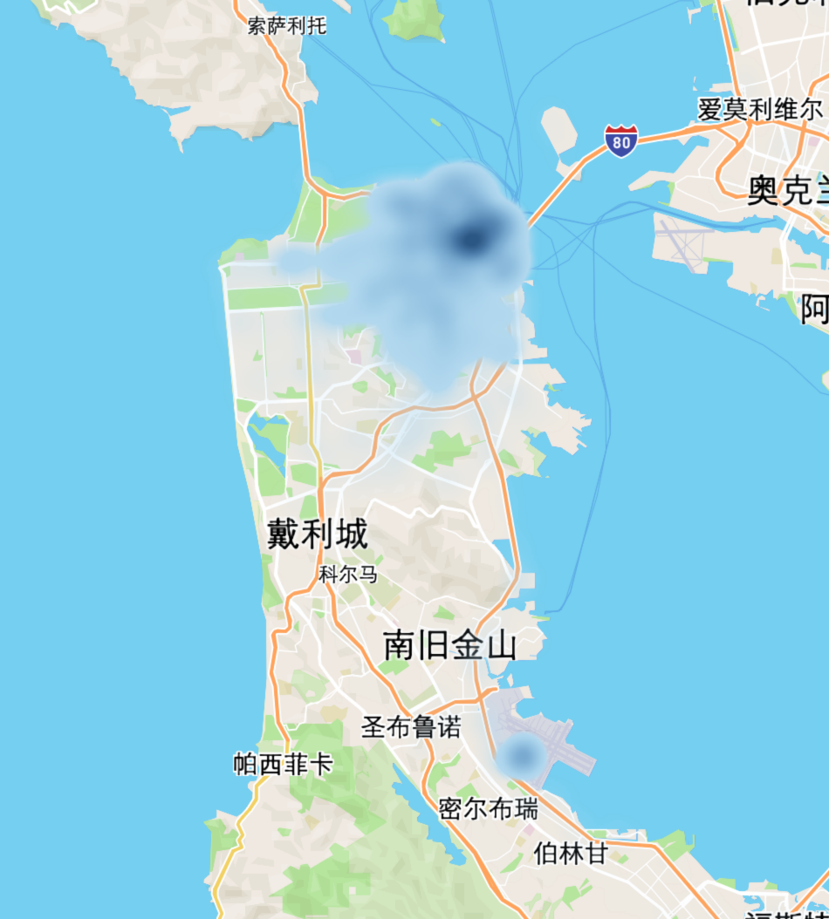
Question 2:
Data visualization and insights
Heat map of taxi location pick up (in) or drop off (out) (Data May 17-21)
The hot area are very centralized
The locations of "in" and "out" are overlapped well,
Reasonable to assume usually a driver is possible to get a passenger near the place where previous passenger left.
Which means for a taxi, the distance to next target place shouldn’t be too long
Picking up passenger point heat map
Dropping off point heat map

Slide 9
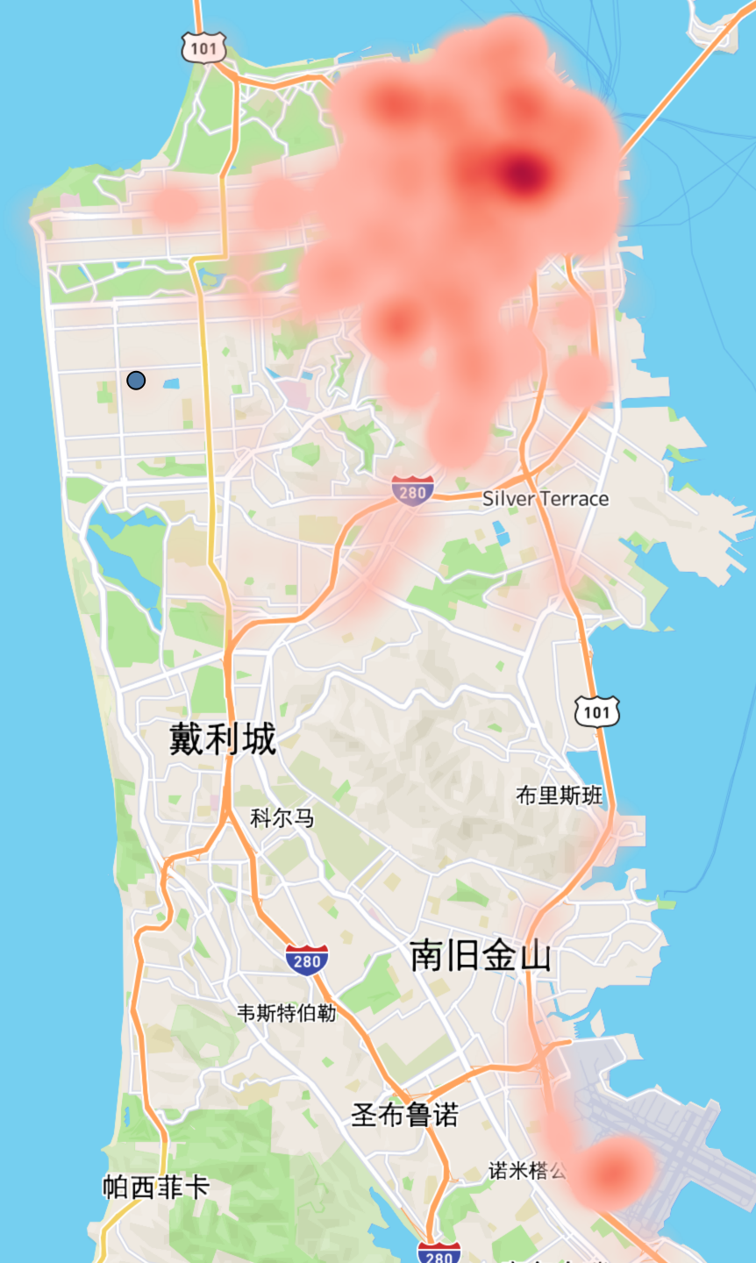
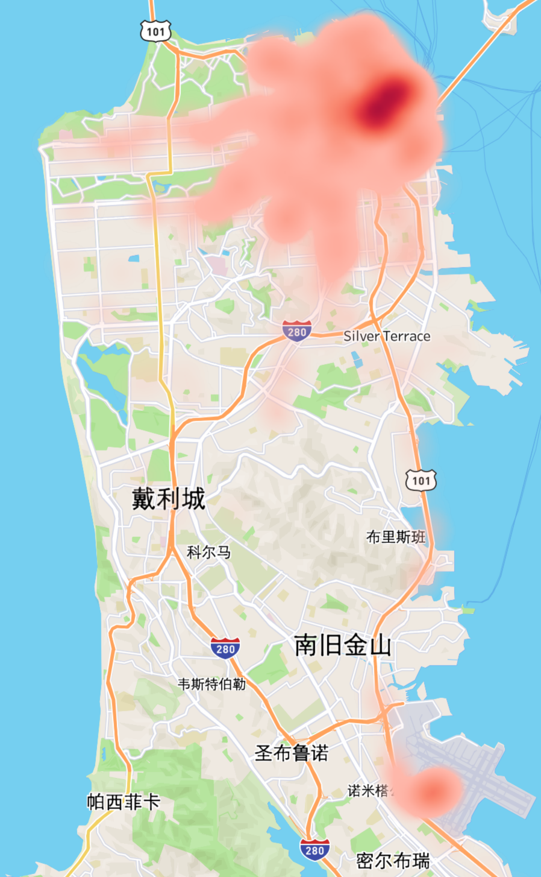
Question 2:
Data visualization and insights
Passengers distribution differs from weekday to weekend
The hot area are very similar but still has some difference
During weekend passenger are dispersed
During weekdays passengers are centralized
Prediction should be day specific
20080601 (Sun.)
20080603 (Wed.)

Slide 10
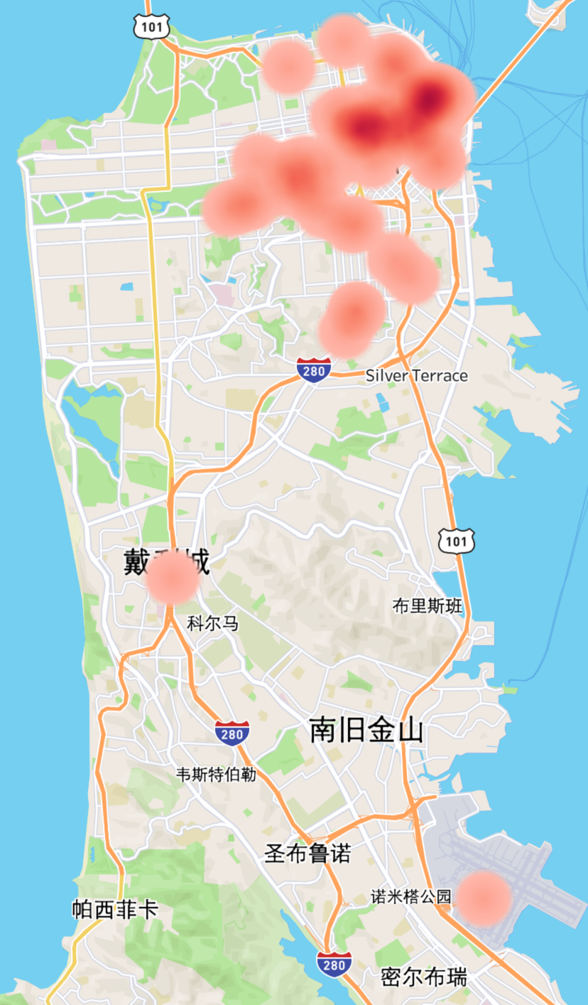
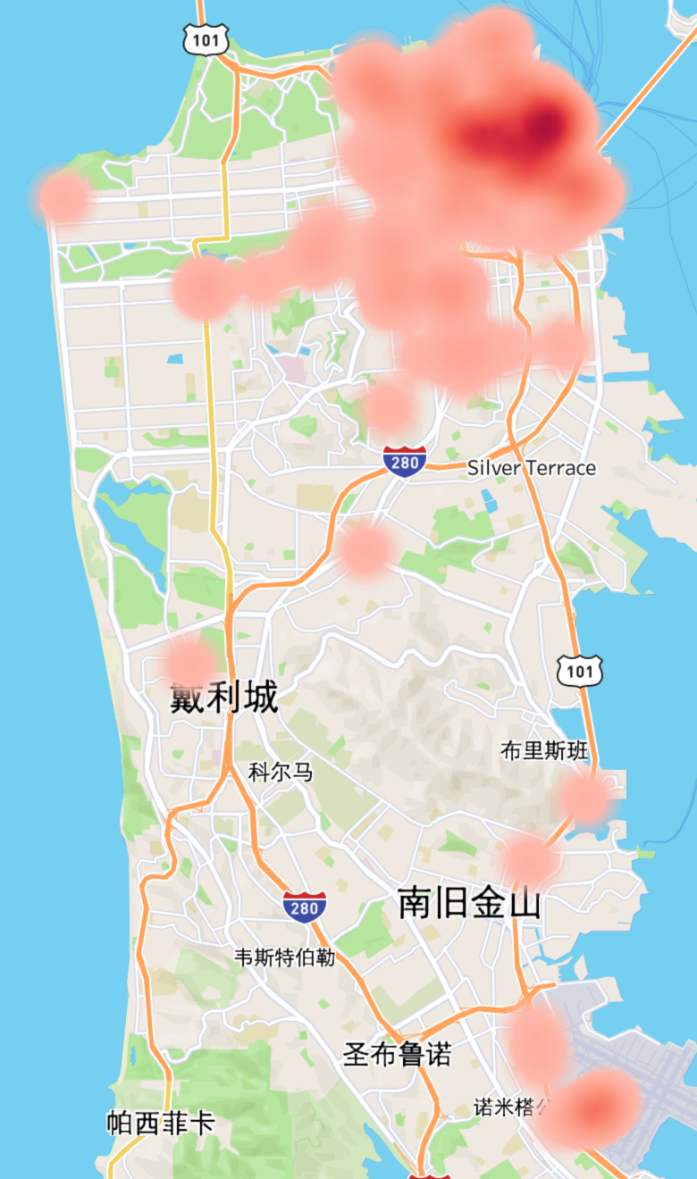
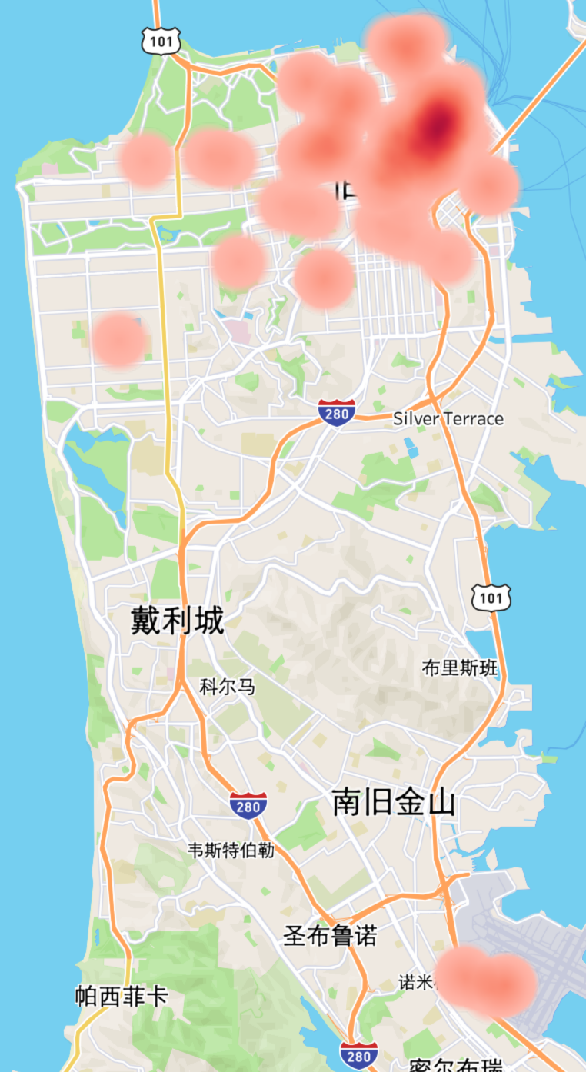
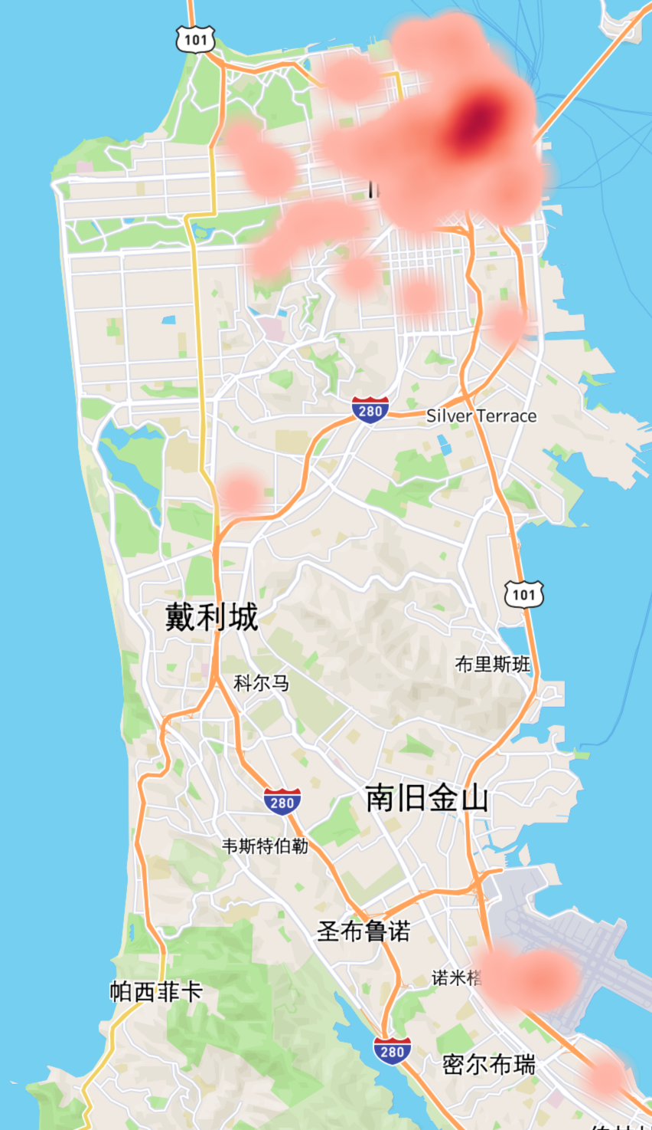
Question 2:
Data visualization and insights
Passengers distribution differs by hours
Prediction should be time-slot specific
00:00
Centralized
Less
06:00
Dispersed
More
12:00
Centralized
Normal
00:00
Centralized
Less

Slide 11



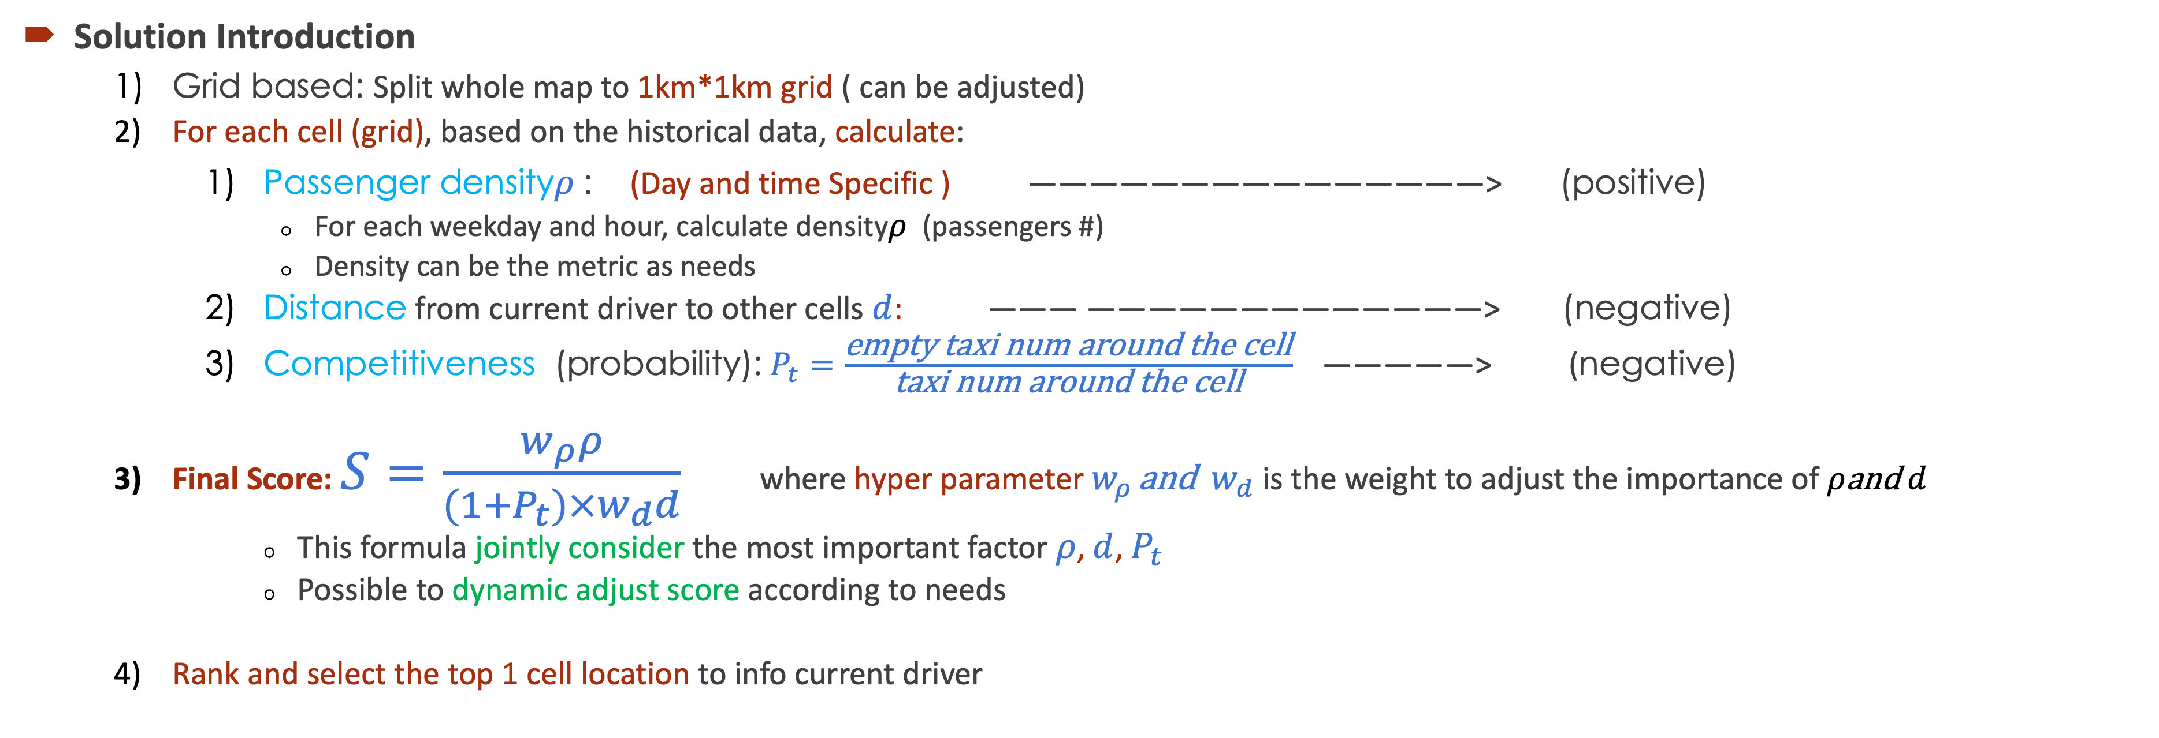
Question 2:
Solution
Solution Introduction
Grid based: Split whole map to 1km*1km grid ( can be adjusted)
For each cell (grid), based on the historical data, calculate:
Passenger density$ρ$ : (Day and time Specific ) ———————————————> (positive)
For each weekday and hour, calculate density$ρ$ (passengers #)
Density can be the metric as needs
Distance from current driver to other cells $d$: ——— —————————————> (negative)
Competitiveness (probability): $P_{t}=\frac{\text{empty} \text{taxi} \text{num} \text{around} \text{the} \text{cell}}{\text{taxi} \text{num} \text{around} \text{the} \text{cell}}$ —————> (negative)
Final Score: $S=\frac{w_{ρ}ρ}{(1+P_{t})×w_{d}d}$ where hyper parameter $w_{ρ }\text{and} w_{d}$ is the weight to adjust the importance of $ρ\text{and} d$
This formula jointly consider the most important factor $ρ$, $d$, $P_{t}$
Possible to dynamic adjust score according to needs
Rank and select the top 1 cell location to info current driver
Model (input, output)
Input |  | Output | Output (optional)
Day, Time | Current driver coordinates | The coordinate of top 1 cell | The coordinates of top k cell
e.g.: Mon. , 8:00 am | (-122.40106, 37.79177) | (-122.40106, 37.79177) | (-122.40106, 37.80177) (-122.40106, 37.81177) (-122.41106, 37.79177)

Slide 12
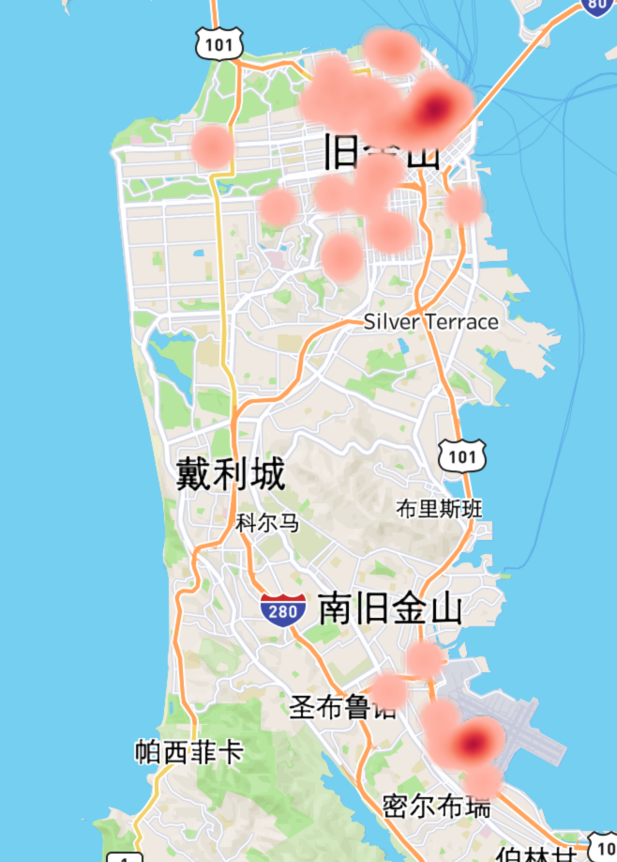
Question 2:
Result
Result Sample
From the two samples, we can see the model could give a next place with high passenger density
The result is near to current place, not just point at highest density place
Which means distance factor in score works
By these two samples, the effectiveness of this model is roughly verified
Sample 1
Model (input, output)
Samples | Input (day, time, lon, lat) |  | Output (next place)
#1 | Mon. 12:00 | (-122.40106, 37.79177) | (-122.4232, 37.7729)
#2 | Mon. 12:00 | (-122.4064, 37.6471) | (-122.3882, 37.6162)
Sample 2

Slide 13
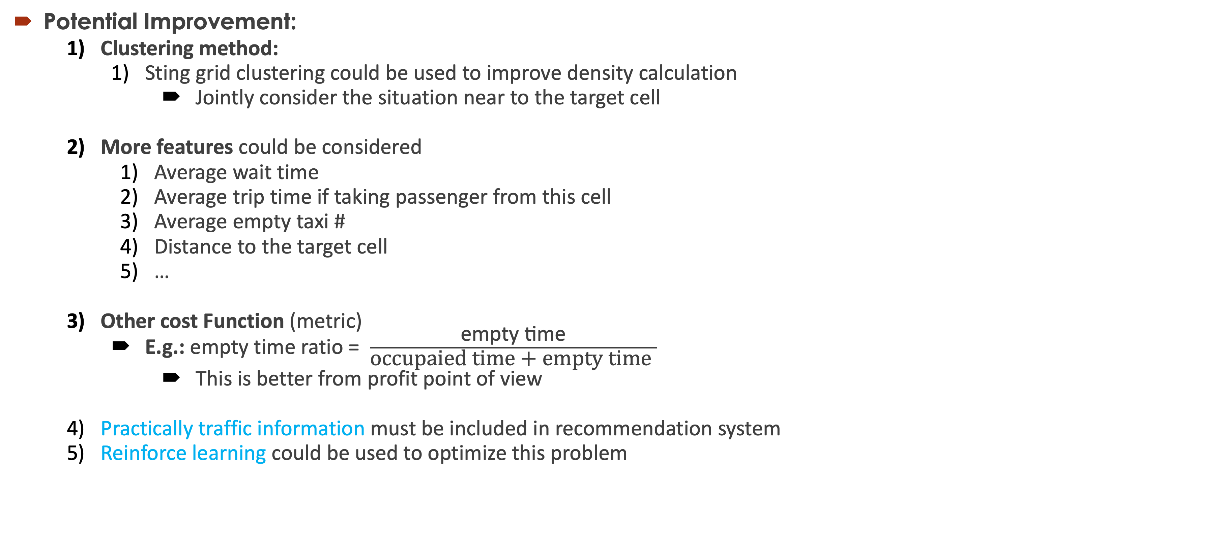
Question 2:
Potential Improvement:
Clustering method:
Sting grid clustering could be used to improve density calculation
Jointly consider the situation near to the target cell
More features could be considered
Average wait time
Average trip time if taking passenger from this cell
Average empty taxi #
Distance to the target cell
…
Other cost Function (metric)
E.g.: empty time ratio = $\frac{\text{empty} \text{time}}{\text{occupaied} \text{time}\text{ + }\text{empty} \text{time} }$
This is better from profit point of view
Practically traffic information must be included in recommendation system
Reinforce learning could be used to optimize this problem

Slide 14
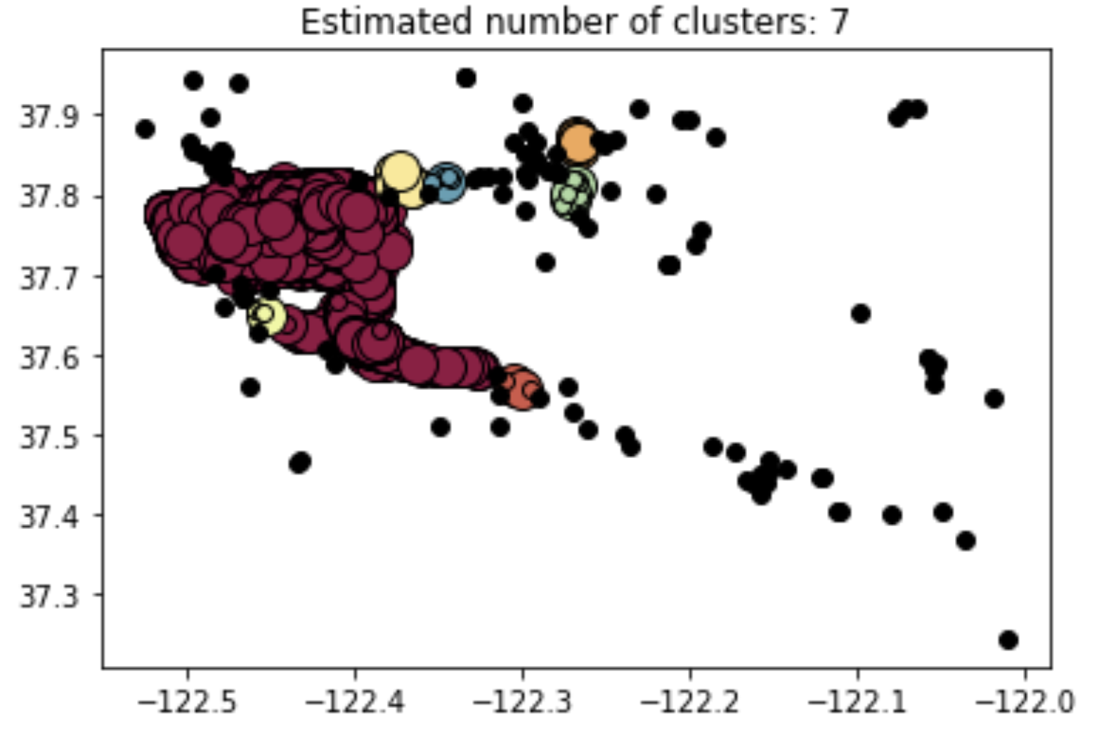
Question 3:
DBSCAN on passengers density
DBSCAN (clustering algorithm) is applied to passengers location (on sampled data)
Totally 7 cluster are found
1 huge cluster: include mostly samples,
considering the limited hot area (from heat map), this is reasonable
Other 6 small clusters: there is relatively good customer need founding
From company point of view:
Specially dispatch some taxies to the 6 small clusters area to better meet customer needs
More profit
DBSCAN result

